Slide 1
LOGISTIC REGRESSION MODELING
Death Prediction using COVID-19 Data
Pravah Malunjkar

Slide 2
TABLE OF CONTENTS
INTRODUCTION | The COVID-19 pandemic and its harsh implecations…
01. DATASET OVERVIEW | The dataset, its capabilities and limitations…
02. SAMPLE DATA | Glimpse of the type of data we are working with…
03. DATA PROCESSING | Cleaning and organizing dataset…
04. DATA VISUALIZATION | An assortment of graphs that are suitable for use in this context…
05. DATA TRAINING & TESTING | Getting the model ready for use…
06. UNDERSAMPLING | Handling the model’s unexpected results…
07. REGRESSION POST UNDERSAMPLING | Useable model and the desired results…

Slide 3
INTRODUCTION
COVID-19 is a highly contagious virus that has infected millions of people around the world. It is caused by the SARS-CoV-2 virus and first emerged in Wuhan, China in December 2019. Since then, it has spread rapidly and has resulted in a global pandemic.
One important aspect of understanding the impact of COVID-19 is analyzing demographic data, which can provide valuable insights into who is most at risk for the virus and how it is affecting different groups of people. Demographic data includes information about age, gender, race, and other characteristics of a population.

Slide 4
PROJECT GOALS
Data Processing
Data Visualization
Training & Testing Data
Regression Modeling
Checking for data unconsistency
Some basic insights to understand the correaltions better
Getting the data ready for modeling
Predicting possible deaths

Slide 5
WHY LOGISTIC REGRESSION?
Logistic regression is used to predict binary outcomes, such as whether a patient will develop a particular disease or if a client will leave. It is a kind of regression analysis that simulates the likelihood that an event will occur based on a set of predictor factors. Here, our data is composed of columns that qualify that criteria. And the predictor values are binary, helping the regression technique.
The link between predictor factors and the outcome can be understood, as well as which predictor variables are most crucial for generating predictions, using this information.
We will better understand this after taking a look at the dataset in the coming slides.

Slide 6
01.
DATASET OVERVIEW
The dataset, its capabilities and limitations…

Slide 7
An large amount of patient-related data, including pre-conditions, is contained in this dataset. 1,048,576 distinct patients and 21 distinctive features make up the raw dataset. 1 denotes "yes" in the Boolean characteristics, while 2 denotes "no." There is no data for the variables 97 and 99.
Thus, after considerable data cleaning and organizing, the major objective of this research is to create a machine learning model that, given a patient's present symptom, condition, and medical history, can determine whether or not the patient is at high risk.
Soon, we will eliminate missing data to avoid flaws in our data visuals.

Slide 8
sex: 1 for female and 2 for male.
age: of the patient.
classification: covid test findings. Values 1-3 mean that the patient was diagnosed with covid in different
degrees: 4 or higher means that the patient is not a carrier of covid or that the test is inconclusive.
patient type: type of care the patient received in the unit. 1 for returned home and 2 for hospitalization.
pneumonia: whether the patient already have air sacs inflammation or not.
pregnancy: whether the patient is pregnant or not.
diabetes: whether the patient has diabetes or not.
copd: Indicates whether the patient has Chronic obstructive pulmonary disease or not.
asthma: whether the patient has asthma or not.
inmsupr: whether the patient is immunosuppressed or not.
hypertension: whether the patient has hypertension or not.
cardiovascular: whether the patient has heart or blood vessels related disease.
renal chronic: whether the patient has chronic renal disease or not.
other disease: whether the patient has other disease or not.
obesity: whether the patient is obese or not.
tobacco: whether the patient is a tobacco user.
usmr: Indicates whether the patient treated medical units of the first, second or third level.
medical unit: type of institution of the National Health System that provided the care.
intubed: whether the patient was connected to the ventilator.
icu: Indicates whether the patient had been admitted to an Intensive Care Unit.
date died: If the patient died indicate the date of death, and 9999-99-99 otherwise.

Slide 9
02.
SAMPLE DATA
Glimpse of the type of data we are working with…

Slide 10
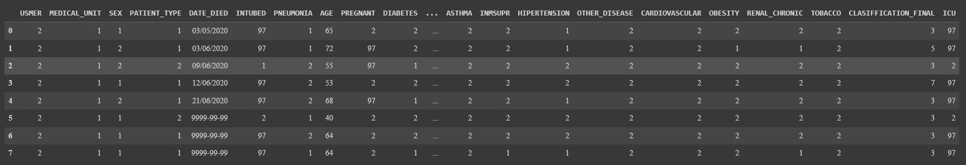
WHAT WE ARE WORKING ON?
Using the .head(n) function we can display the first ‘n’ data rows of the dataset.

Slide 11
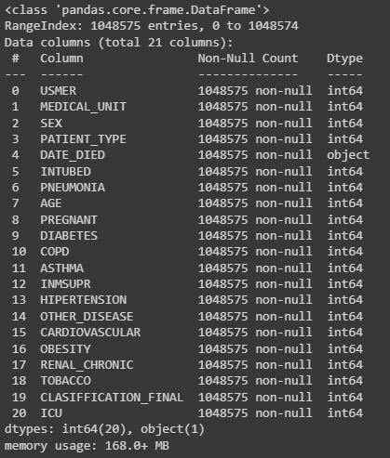
ABOUT THE DATASET
Using the .describe() function we can display the information regarding the structure of the dataset.
Considering that most of the data is numerical we should not have many obstacles while data visualization, training and testing phases.

Slide 12
03.
DATA PROCESSING
Cleaning and organizing dataset…

Slide 13
WHAT WE ARE WORKING ON?
Some of our features have three or four distinct values while we had anticipated that they would only have two. For instance, the characteristic "PNEUMONIA" contains three distinct values: 1, 2, and 99, where 99 denotes NaN values. Therefore, we will only select the rows that have the values 1 and 2.
We have 971633 "9999-99-99" values in the "DATE DIED" column, which reflect patients who are still alive. I will interpret this characteristic as a "DEATH," which includes whether the patient actually passed away or not.

Slide 14
DATA CHECK
covid = covid[(covid.PNEUMONIA == 1) | (covid.PNEUMONIA == 2)]
covid = covid[(covid.DIABETES == 1) | (covid.DIABETES == 2)]
covid = covid[(covid.COPD == 1) | (covid.COPD == 2)]
covid = covid[(covid.ASTHMA == 1) | (covid.ASTHMA == 2)]
covid = covid[(covid.INMSUPR == 1) | (covid.INMSUPR == 2)]
covid = covid[(covid.HIPERTENSION == 1) | (covid.HIPERTENSION == 2)]
covid = covid[(covid.OTHER_DISEASE == 1) | (covid.OTHER_DISEASE == 2)]
covid = covid[(covid.CARDIOVASCULAR == 1) | (covid.CARDIOVASCULAR == 2)]
covid = covid[(covid.OBESITY == 1) | (covid.OBESITY == 2)]
covid = covid[(covid.RENAL_CHRONIC == 1) | (covid.RENAL_CHRONIC == 2)]
covid = covid[(covid.TOBACCO == 1) | (covid.TOBACCO == 2)]
Getting rid of the missing values of features except "INTUBED", "PREGNANT", "ICU"

Slide 15
DATA CHECK
Using covid.isna().sum().sum() we get that there are no NaN values but missing values do exist.
We use, for i in covid.columns:
print(i,"=>\t",len(covid[i].unique()))
and get unique values of each data column.
Upon doing covid.DATE_DIED.value_counts() we get that an invalid date entry exists. Thus we correct it using
covid["DEATH"] = [2 if each=="9999-99-99" else 1 for each in covid.DATE_DIED]

Slide 16
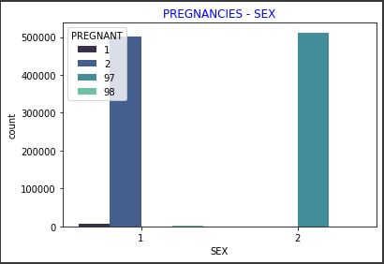
DATA CHECK with GRAPHS
Here, in SEX,
1 = Male
2 = Female
Since men cannot become pregnant, we shall change all values beginning with "97" to 2.
covid.PREGNANT = covid.PREGNANT.replace(97,2)
covid = covid[(covid.PREGNANT == 1) | (covid.PREGNANT == 2)]

Slide 17
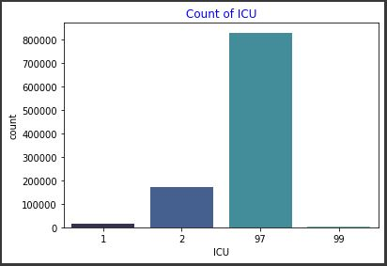
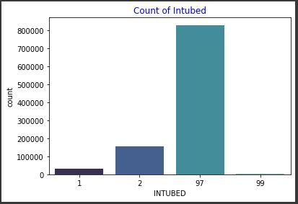
MISSING VALUE ANALYSIS
ICU
INTUBED
Too many values are missing from the "INTUBED" and "ICU" features, therefore I'm dropping them. Additionally, since we previously used this feature as a "DEATH" feature, we no longer need the "DATE DIED" column.
covid.drop(columns=["INTUBED","ICU","DATE_DIED"], inplace=True)

Slide 18
04.
DATA VISUALIZATION
An assortment of graphs that are suitable for use in this context…

Slide 19
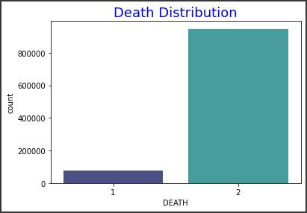
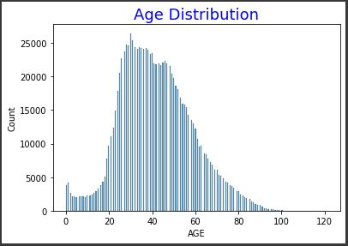
DISTRIBUTION METRICS
The distribution of the values in the target column is imbalanced. This will likely result in an imbalance issue.
Patients often range in age from 20 to 60.

Slide 20
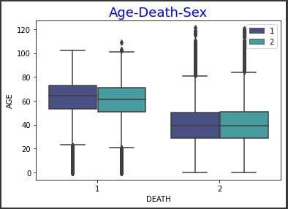
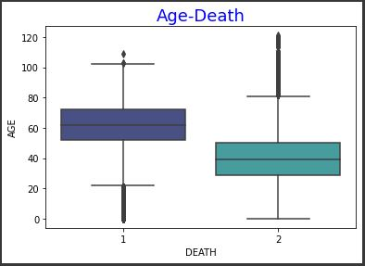
DISTRIBUTION METRICS
Compared to younger patients, older patients have a higher mortality rate. When it comes to the average patient rate, there are no significant differences between males and females.

Slide 21
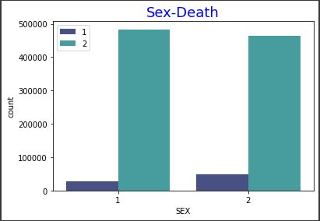
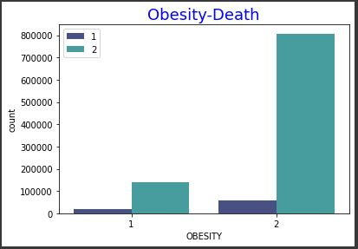
DISTRIBUTION METRICS
Compared to females, men are more likely to die from COVID. Patients who are fat have a higher risk of dying from COVID than patients who are not obese.

Slide 22
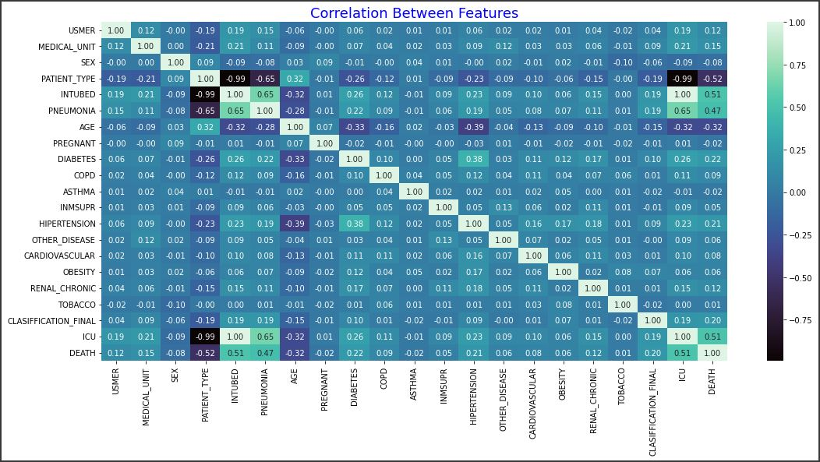
CORRELATION ANALYSIS

Slide 23
05.
TRAINING & TEST DATA
Getting the model ready for use…

Slide 24
PREREQUISITES
The features that have little link with the "DEATH" feature will be dropped.
unrelevant_columns = ["SEX","PREGNANT","COPD","ASTHMA","INMSUPR","OTHER_DISEASE","CARDIOVASCULAR",
"OBESITY","TOBACCO"]
covid.drop(columns=unrelevant_columns,inplace=True)
Non-binary features
covid = pd.get_dummies(covid,columns=["MEDICAL_UNIT","CLASIFFICATION_FINAL"],drop_first=True)
Setting x and y
x = covid.drop(columns="DEATH")
y = covid["DEATH"]

Slide 25
TRAIN TEST SPLIT
from sklearn.model_selection import train_test_split
train_x, test_x, train_y, test_y = train_test_split(x,y, test_size=0.2, random_state=42)
from sklearn.linear_model import LogisticRegression
logreg = LogisticRegression()
logreg.fit(train_x,train_y)
print("Logistic Regression Accuracy :",logreg.score(test_x, test_y))
Logistic Regression Accuracy : 0.9394117301708448 indicates that the model’s accuracy and deployability is high.
from sklearn.metrics import f1_score
print("Logistic Regression F1 Score :",f1_score(test_y,logreg.predict(test_x),average=None))]
Logistic Regression F1 Score : [0.51880634 0.96767052] indicates that the model is performing well on the continuous target variables.

Slide 26
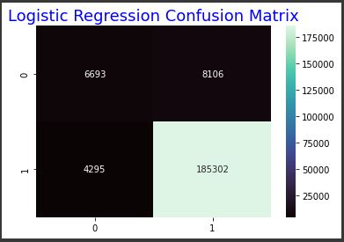
CONFUSION MATRIX
With Logistic Regression, we achieved good accuracy.
However, it is prone to error, thus we must double-check the other metrics.
The F1 Score indicates that we anticipated the patients who survived well, but we are unable to make the same claim for the patients who passed away.
When we look at the confusion matrix, we also observe the same thing. As I indicated, this issue is predicated on the imbalance dataset.

Slide 27
06.
UNDERSAMPLING
Handling the model’s unexpected results…

Slide 28
SOLVING DATASET IMBALANCE
Adding Additional Data
The Performance Metrics Must Be Changed
Re-sampling (either under- or over-sampling), algorithm change, penalized models, etc.
Why we must undersample:
Undersampling: Keeping all the data in the minority class and reducing the size of the majority class is a method for balancing out unbalanced datasets. Because there are too many rows for the computer to handle, we must use undersampling.

Slide 29
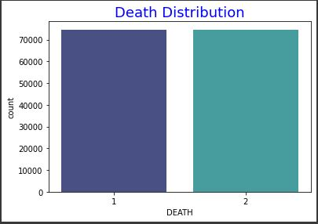
DISTRIBUTION CHECK
from imblearn.under_sampling import RandomUnderSampler
rus = RandomUnderSampler(random_state=0)
x_resampled,y_resampled = rus.fit_resample(x,y)
ax = sns.countplot(y_resampled, palette="mako")
plt.title("Death Distribution", fontsize=18,color="blue");

Slide 30
07.
REGRESSION POST UNDERSAMPLING
Useable model and the desired results…

Slide 31
TRAIN TEST SPLIT POST UNDERSAMPLING
train_x, test_x, train_y, test_y = train_test_split(x_resampled,y_resampled, test_size=0.2, random_state=42)
logreg = LogisticRegression()
logreg.fit(train_x,train_y)
print("Logistic Regression Accuracy :",logreg.score(test_x, test_y))
Logistic Regression Accuracy : 0.9052004152295483 indicates that the model’s accuracy and deployability is still high enough to use for our prediction.
print("Logistic Regression F1 Score :",f1_score(test_y,logreg.predict(test_x),average=None))
Logistic Regression F1 Score : [0.90619305 0.90418655] indicates that the model is performing well on the continuous target variables.

Slide 32
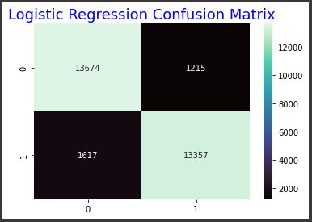
CONFUSION MATRIX
For the model’s predictions to be accurate:
True positives > False negatives
False positives < True negatives
Here, the number of true positives (13674) is much larger than the number of false negative (1215). Similarly, the number of false positives (1617) is much less than the number of true negatives (13357).
Thus after the evaluation of our regression model on this dataset, the confusion matrix proves the performance based on the numbers mentioned above.

Slide 33
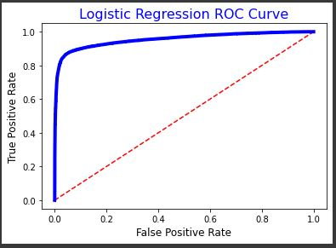
LOGISTIC REGRESSION CURVE
A receiver operating characteristic (ROC) curve is a graphical representation that shows how a binary classifier system's diagnostic capacity changes with its discrimination threshold. The closer the curve is to the top left corner of the plot, the better the model is at accurately predicting positive outcomes.
The area under the curve (AUC) can also be used to evaluate the performance of the model. A value of 0.5 indicates a poor model, while a value greater than 0.7 indicates a good model. A value of 1 indicates a perfect model.

Slide 34
THANK YOU!

